Slide 1

MiYE – Mud in Your Eye
Resort Spa Reservation Application

Slide 2
Application Features
Login - User Authentication & Authorization
Management – Service & Customer
Billing – View & Print Service Reports
Reservations – Create, Cancel & View

Slide 3
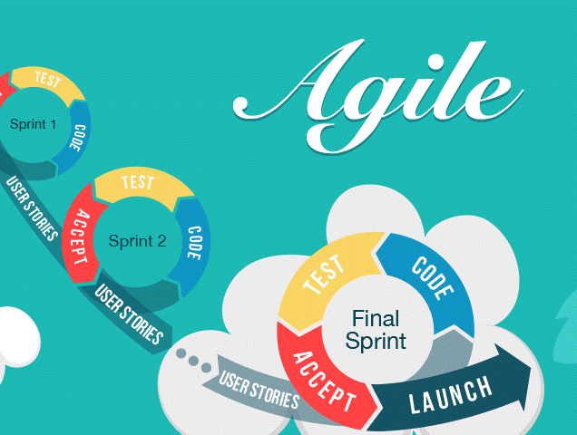
Agile Software Development Process
Multiple Iterations
Team Roles
Team Schedule
Communication Paths
Milestone Deliverable

Slide 4


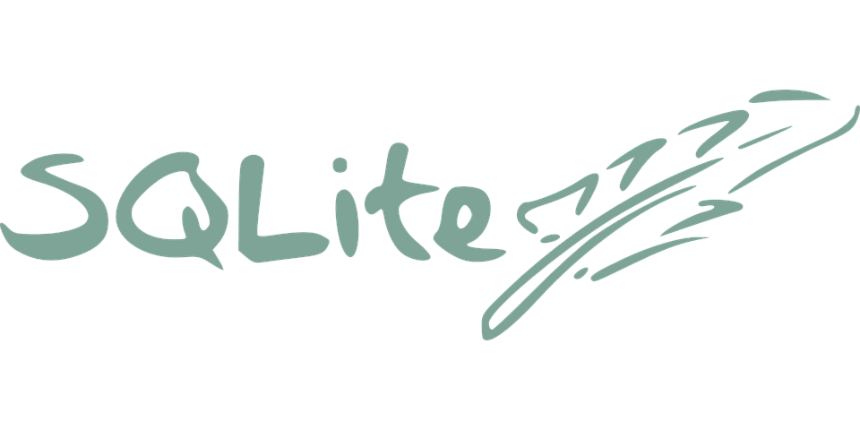



Tools & Applications
Language: Python 3
Framework: Django
Frontend: jQuery/html/ES6
Database: SQLite 3
GitHub
Slack
Trello

Slide 5
Established clear communication paths
Define best practices and conventions
Create a meaningful definition of done and good enough
Getting Our Process Started

Slide 6
Next...
Set up our environment, tools, and applications
Avoid having multiple document management systems
Prepared the codebase and project structure

Slide 7
Timelines and Schedules
GitHub
Weekly Iterations
Milestone 1 after week 4
Agreed to team members schedules (nights and weekends)
Created our project and version branching
Created our documentation
Created our Wiki pages
Manage issues
Began testing

Slide 8

Live Demonstration

Slide 9
Q&A
Karen Snow - Business Design, Programmer
Okechukwu Ugwuanyi - UI Design, Programmer
Haibo Yan - System Design, Programmer

